Slide 1


Slide 2


Live Session On : Core on Semantic Processing
Instructor : Tanisha Medewala

Slide 3
Agenda
1.
Why Semantic Processing
2.
Foundations of Meaning – Lexical Semantics, Ambiguity Problem, Lexical Relations
3.
Representation & WSD: Representing Meaning, Task 1 WSD
4.
NER & IOB Tagging : Task 2 NER and IOB Labelling Scheme
5.
Models for NER (CRF): How NER Models work, Visualizing CRF Features
6.
SRL & Conference: Task 3 Semantic Role Labelling & Task 4 Coreference Resolution
Notes:
Note to SMEs: Start the session with a recall of the concepts taught in core content would help build a connection between the two
For example, if teaching a session on e-skills, asking the learners what they understood from the first module or the core concepts that were taught in module

Slide 4
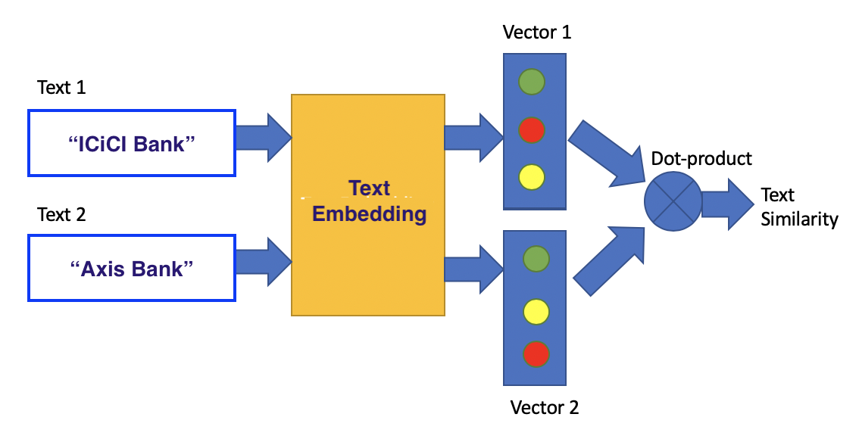
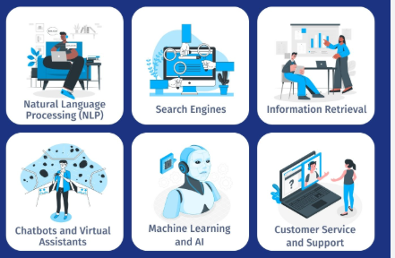
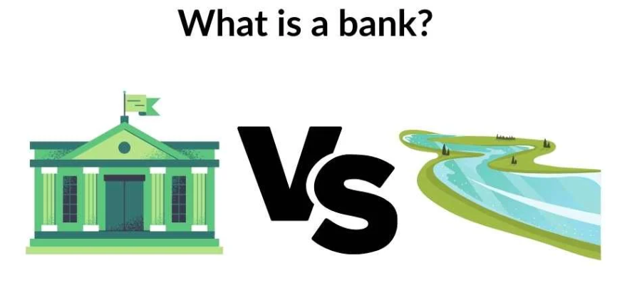
Key Reasons for Semantic Processing
Deeper Understanding
Semantic processing helps us connect new information to what we already know.
This integration builds comprehension rather than rote memorization.
Better Memory Retention
According to the Levels of Processing Theory (Craik & Lockhart, 1972), the deeper (more semantic) the processing, the stronger and more durable the memory trace.
For example, remembering a word by thinking about its meaning (“A cat is an animal that purrs”) is more effective than focusing on its sound or appearance (“cat rhymes with hat”).
Efficient Retrieval
Meaning-based connections make it easier to recall information later because retrieval cues are linked conceptually.
For instance, thinking of “fruit” can trigger “apple” or “banana,” showing how semantic networks support recall.
Application and Problem Solving
Understanding meaning enables people to apply knowledge flexibly in new contexts — essential for reasoning, creativity, and critical thinking.

Slide 5
Lexical Semantics
Lexical semantics is a subfield of linguistics and semantics that studies the meaning of words — how individual words convey meaning, how those meanings are structured in the mental lexicon (our mental “dictionary”), and how words relate to one another within a language.
In simple terms:
Lexical semantics is the study of word meaning and word relationships.
It focuses on understanding how words represent concepts, how meaning changes across contexts, and how words connect within networks of related meanings.
1. Word-Level Meaning
Word-level meaning refers to the meaning that is attached to individual words — that is, what a word stands for or represents in the mind and in the world.
There are two major aspects of word-level meaning:
a. Denotative Meaning (Literal meaning)
This is the core, dictionary definition of a word.
Example:
  Dog → “a domesticated carnivorous mammal (Canis familiaris).”
b. Connotative Meaning (Associated meaning)
This includes emotional, cultural, or situational associations that a word carries beyond its literal meaning.
Example:
  Home → literally “a place where one lives” (denotation), but connotes warmth, comfort, safety, and family.
c. Sense and Reference
Sense: the mental concept or meaning of a word within the language system.
Example: “The morning star” and “the evening star” have different senses but the same reference (both refer to Venus).
Reference: the actual entity or object in the real world that the word refers to.
2. Word Relations in Lexical Semantics
Words are not isolated; they exist in networks of semantic relations. These relations help us understand how words interact and differ in meaning.
Here are the main types:
a. Synonymy (Similarity in meaning)
Words with similar or nearly identical meanings.
Example: Big ↔ Large, Buy ↔ Purchase.
b. Antonymy (Opposition in meaning)
Words with opposite meanings.
  Gradable antonyms: opposites on a scale (hot ↔ cold, tall ↔ short).
  Complementary antonyms: mutually exclusive (alive ↔ dead).
  Relational antonyms: opposite roles (teacher ↔ student, buy ↔ sell).
c. Hyponymy (Class–subclass relationship)
A hierarchical relationship where one word (the hyponym) is a specific instance of another (the hypernym).
Example:
  Rose, lily, tulip → hyponyms of flower (hypernym).
d. Meronymy (Part–whole relationship)
One word denotes a part of something else.
Example: Wheel is a meronym of car; branch is a meronym of tree.
e. Polysemy (One word, multiple related meanings)
A single word with multiple, related senses.
Example: Head → can mean the top of a body, a leader (“head of department”), or the front of something (“head of a table”).

Slide 6
f. Homonymy (One form, unrelated meanings)
Words that sound or look the same but have unrelated meanings.
Example: Bank (financial institution) vs. Bank (river edge).
g. Collocation
Words that tend to occur together naturally in language.
Example: Strong tea (not powerful tea), make a decision (not do a decision).
3. Importance of Lexical Semantics
Lexical semantics is crucial in many fields:
Language teaching and learning – helps understand word meaning and usage.
Lexicography – for creating dictionaries.
Natural Language Processing (NLP) – in AI and machine translation systems.
Cognitive linguistics – to study how humans conceptualize and categorize the world through language

Slide 7
Difference Between Polysemy & Homonymy
🧩 1. Polysemy – One Word, Related Meanings
Definition:
Polysemy occurs when a single word has multiple meanings that are conceptually related or derived from a common origin.
These meanings often share a core idea or semantic connection.
Key Idea:
➡ One word – many related senses
Examples:
Head
  The upper part of the body (body part)
  A person in charge (head of department)
  The front or top part of something (head of a table, head of a queue)
  👉 All meanings relate to the idea of being at the top or in a leading position.
Foot
  The lower part of the leg (body part)
  The base of a mountain (foot of the hill)
  The bottom of a page (footnote)
  👉 All meanings share the idea of being at the bottom or base.
Paper
  Material for writing (a sheet of paper)
  A written article (a research paper)
  A newspaper (the morning paper)
  👉 All are related to writing or printed material.
Mouth
  The opening in a face used for eating or speaking
  The opening of a river (the mouth of the Nile)
  👉 Both convey the idea of an opening or entrance.
🪞 2. Homonymy – One Form, Unrelated Meanings
Definition:
Homonymy occurs when two (or more) words sound the same or are spelled the same, but have entirely different and unrelated meanings.
These words usually come from different origins (etymologies).
Key Idea:
➡ One form – two (or more) unrelated words
Examples:
Bank
  Financial institution (She deposited money in the bank.)
  The side of a river (The boat reached the river bank.)
  👉 Meanings are unrelated — one is about finance, the other about geography.
Bat
  A flying mammal (A bat flew out of the cave.)
  A wooden club used in sports (He swung the baseball bat.)
  👉 No conceptual link — they just happen to share the same form.
Seal
  A sea animal (We saw a seal at the zoo.)
  A stamp or emblem used for closing documents (The king’s seal on the letter.)
  👉 Unrelated meanings; one is an animal, the other a symbol/tool.
Lie
  To recline (I lie on the bed.)
  To tell a falsehood (He lied about his grades.)
  👉 Two totally separate verbs with different roots.

Slide 8
Polysemy vs Homonymy
Feature | Polysemy | Homonymy
Meaning Relationship | Meanings are related | Meanings are unrelated
Origin | Usually same origin (etymology) | Usually different origins
Example | Head → body part / leader / top | Bat → animal / sports equipment
Cognitive Connection | Meanings share a core concept | Meanings share form only
Dictionary Entry | Often under one entry with sub-senses | Often under separate entries

Slide 9
WordNet Approach
🌐 1. What is WordNet?
WordNet is a large lexical database of English developed at Princeton University (by George A. Miller and team).
It organizes English words into sets of synonyms called synsets (short for synonym sets) and connects them through a variety of semantic relations.
So in WordNet:
car, automobile, and motorcar belong to the same synset (they share one meaning).
bank has multiple synsets (different meanings = polysemy).
🧭 2. Structure of WordNet
WordNet is organized as a semantic network, where:
Nodes = synsets (concepts/meanings)
Edges = semantic relations between synsets
Each part of speech has its own sub-network:
Nouns: objects, entities, people, etc.
Verbs: actions, processes, states
Adjectives: properties, qualities
Adverbs: manner, time, degree
🧩 Core Idea
WordNet models meaning not just as individual words, but as networks of related concepts.
Instead of treating “word = meaning,” WordNet treats “word” as a surface form and “synset” as a conceptual meaning unit.
Each synset represents one specific sense (or meaning) of a word.
car
├── Synonyms: automobile, auto, motorcar
├── Hypernym (is-a): motor vehicle
│ └── Hypernym: vehicle
│ └── Hypernym: conveyance, transport
├── Hyponyms (types of car):
│ ├── ambulance
│ ├── police car
│ ├── sports car
│ └── taxi
├── Meronyms (parts of car):
│ ├── wheel
│ ├── engine
│ └── door
└── Holonym (whole to which car belongs): fleet
Word | Synset | Definition
car | {car, auto, automobile, machine, motorcar} | “A motor vehicle with four wheels; usually propelled by an internal combustion engine.”
bank (financial) | {bank, depository financial institution} | “A financial institution that accepts deposits and channels the money into lending activities.”
bank (river) | {bank, riverside} | “The slope beside a body of water.”

Slide 10
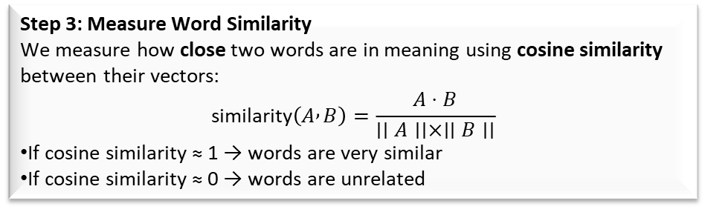
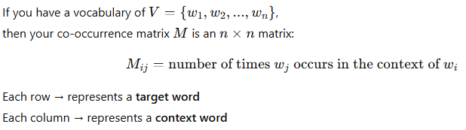
Distributional Approach
“You shall know a word by the company it keeps.” — J.R. Firth, 1957
This is the core idea of the distributional approach.
It means:
The meaning of a word can be inferred from the context in which it appears.
Words that occur in similar contexts are likely to have similar meanings.
So, we don’t need a dictionary (like WordNet) — instead, we learn meaning directly from text data.
Word | drive | road | wheel | river | money
car | 5 | 3 | 4 | 0 | 0
bus | 4 | 3 | 3 | 0 | 0
bank | 0 | 0 | 0 | 4 | 5
Step 1: Intuitive Example
Let’s look at these sentences:
1. I drove my car to the office.
2. She bought a new automobile yesterday.
3. The bus stopped near the station.
If you look closely:
The words car, automobile, and bus appear with drive, stop, station, buy, etc.
So, statistically, they often occur in similar contexts.
➡️ That’s the key:
If two words have similar neighboring words, they probably have similar meanings.
A co-occurrence matrix (also called a word–context matrix) shows how often words occur together within a given context window (like a sentence or a few neighboring words).
It captures the distributional context of each word.
Step 2: Turn Words into Numbers
We represent words as vectors — basically, lists of numbers — based on how often they co-occur with other words.
Notice:
car and bus have similar patterns, so they’re semantically related.
bank is totally different — it means something else.

Slide 11
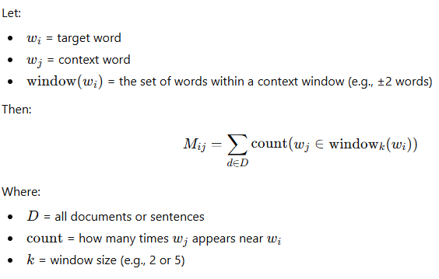
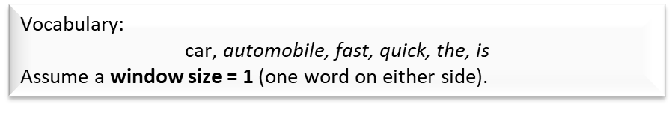
Distributional Approach
Target (row) | the | car | is | fast | automobile | quick
the | 0 | 1 | 2 | 0 | 1 | 0
car | 1 | 0 | 1 | 1 | 0 | 0
is | 2 | 1 | 0 | 1 | 1 | 1
fast | 0 | 1 | 1 | 0 | 0 | 0
automobile | 1 | 0 | 1 | 0 | 0 | 1
quick | 0 | 0 | 1 | 0 | 1 | 0
Aspect | WordNet (Network-based) | Distributional (VSM-based)
Nature | Symbolic / Knowledge-based | Statistical / Data-driven
Representation | Words are nodes in a semantic network connected by labeled relations (synonym, hypernym, etc.) | Words are vectors in a high-dimensional space, learned from text co-occurrence
Meaning Source | Handcrafted by linguists | Learned automatically from large corpora
Philosophy | Meaning = relationships between concepts | Meaning = usage patterns in context (“you shall know a word by the company it keeps”)
The car is fast.
The automobile is quick.

Slide 12
WSD
🌐 1. What is Word Sense Disambiguation (WSD)?
Definition:
Word Sense Disambiguation (WSD) is the process of identifying which sense (meaning) of a word is used in a given context.
In English, many words are ambiguous — they have multiple meanings (polysemy).
🎯 3. The Goal of WSD
To determine the correct meaning (sense) of an ambiguous word based on its surrounding words (context).
🧠 4. Lesk Algorithm — The Idea
The Lesk algorithm (Michael Lesk, 1986) is a dictionary-based approach to WSD.
It uses WordNet glosses (definitions) to find which sense best matches the context.
🔹 Basic Idea:
The correct sense of a word is the one whose definition shares the most words in common with the context of the sentence.
🧩 2. Why does this problem occur?
Because words often have multiple senses, e.g.:
Word | Possible Meanings (Senses) | Example Sentence
bank | 1️⃣ Financial institution 2️⃣ River side | “He sat by the bank.” → which one?
bat | 1️⃣ Animal 2️⃣ Sports equipment | “He swung the bat.”
pen | 1️⃣ Writing tool 2️⃣ Animal enclosure | “The farmer built a pen.”
🪄 5. Step-by-Step Example:
Let’s disambiguate the word “bank” in the sentence:
“He sat on the bank of the river.”
Step 1️⃣: Identify the ambiguous word
→ “bank”
Step 2️⃣: Retrieve all senses from WordNet
bank (n1): financial institution
“a financial institution that accepts deposits and channels the money into lending activities.”
bank (n2): river edge
“sloping land beside a body of water.”
Step 3️⃣: Take context words
Context: “He”, “sat”, “on”, “river”
Step 4️⃣: Compare overlap
We check how many words from each definition (and example sentences) overlap with the context
The same word can mean very different things depending on its context.
Sense | Definition (simplified) | Overlapping words with “He sat on the river”
Financial Institution | money, deposits, lending | ❌ None
River Edge | sloping land, body, water | ✅ “river”, “water” (related words)

Slide 13
NER
🧩 1. What is Named Entity Recognition (NER)?
Named Entity Recognition (NER) is an NLP task that automatically identifies and classifies real-world entities mentioned in text into predefined categories such as:
👤 PER → Person names
🏢 ORG → Organizations
🌍 LOC → Locations
💰 MISC → Miscellaneous (like dates, times, nationalities, events, products, etc.)
4. Why is NER Required? (Importance)
NER is crucial because it extracts structured knowledge from unstructured text — a key step in many NLP applications.
🔹 1. Information Extraction
Identify “who did what where” from large documents.
e.g., Extract company names and locations from news reports.
🔹 2. Search and Recommendation
Improve search accuracy by detecting entity-based queries.
“Hotels near Eiffel Tower” → Eiffel Tower recognized as a LOC
🔹 3. Knowledge Graph Construction
NER helps build relationships between entities.
“Steve Jobs founded Apple” → connects PER–ORG
🔹 4. Question Answering (QA)
NER helps detect entities the question refers to.
“Who is the CEO of Google?” → detects Google (ORG)
🔹 5. Summarization and Analytics
Extract key entities from reports, research papers, or social media posts.
NER = the process of detecting and labeling words or phrases that refer to specific entities in text.
🧠 2. Example of NER in Action
Input text:
"Barack Obama visited Microsoft headquarters in Seattle on Monday."
NER output:
Entity | Type
Barack Obama | PER (Person)
Microsoft | ORG (Organization)
Seattle | LOC (Location)
Monday | MISC (Date/Time)
⚙️ 5. How NER Works (Conceptually)
NER typically involves two sub-tasks:
Detection: Locate entity boundaries (e.g., "New York" → two tokens, one entity)
Classification: Assign the correct label (LOC, PER, ORG, etc.) ./,
Some systems also include finer-grained tags like DATE, TIME, PRODUCT, EVENT, LAW, etc. depending on the corpus or NER model (e.g., spaCy, BERT-NER, CoNLL).

Slide 14
NER
Approach | Description | Example
Rule-based | Uses dictionaries & regular expressions | "Mr." followed by capitalized word → PER
Statistical (ML-based) | Learns patterns using annotated data | Hidden Markov Models, CRFs
Neural (Deep Learning) | Contextual embeddings to identify entities | BERT, spaCy, LSTM-CRF

Slide 15
IOB Labelling
🧩 1. What Is IOB Labeling?
IOB stands for Inside–Outside–Beginning,
and it’s a token-level annotation scheme used in NLP to mark the boundaries of entities (like people, places, organizations, etc.) inside a sentence.
It’s also called the BIO scheme (they’re the same thing).
📘 2. Why Do We Need IOB Tagging?
There are three main reasons:
🔹 (A) To Represent Multi-word Entities
Entities often span multiple words:
“New York City” → one entity (Location)
But a model processes tokens one by one:
[“New”, “York”, “City”]
Without boundary markers, the model can’t tell that these words together make up one single entity.
✅ IOB solves that:
🧠 Think of it this way:
When an NER model reads a sentence, it doesn’t “see” named entities as chunks — it sees tokens (words).
So we must label each token individually to indicate:
if it starts an entity,
continues one,
or isn’t part of any entity.
That’s exactly what IOB tagging does.
Label | Meaning | Example
B-XXX | Beginning of an entity of type XXX | B-PER (Barack)
I-XXX | Inside (continuation) of the same entity type | I-PER (Obama)
O | Outside of any entity | O (visited, in, the)
🔹 (B) For Model Training and Evaluation
Machine learning models (like CRFs, LSTMs, BERT) need token-level supervision during training.
IOB provides:
Granular supervision (word-by-word)
Clear transitions (e.g., B → I → O)
Consistency (same across datasets like CoNLL)
This allows the model to learn:
“Whenever I see a capitalized word after ‘Mr.’ → B-PER”
Token | Tag
New | B-LOC
York | I-LOC
City | I-LOC

Slide 16
IOB Labelling
🔹 (C) To Reconstruct Entities Later
After prediction, we can easily rebuild full entities from IOB tags.
Example:
Barack/B-PER Obama/I-PER visited/O Microsoft/B-ORG
→ Model output can be reconstructed into:
PERSON: “Barack Obama”
ORG: “Microsoft”
So IOB acts as a bridge between:
token-level prediction
and
phrase-level (entity-level) understanding.
Token | Tag | Explanation
Barack | B-PER | Beginning of person
Obama | I-PER | Inside same person
visited | O | Not entity
Microsoft | B-ORG | Beginning of organization
headquarters | I-ORG | Inside organization
in | O | Outside
Seattle | B-LOC | Beginning of location
. | O | Outside
🧮 3. IOB Tagging Rules
B-XXX
→ Used at the start of an entity, or when a new entity of the same type begins immediately after another.
I-XXX
→ Used for tokens inside the same entity.
O
→ Used for non-entity tokens (outside).
Consistency Rule:
If an I-XXX appears without a preceding B-XXX, it is typically treated as a B-XXX (start of a new entity).
⚙️ How IOB Works Internally (Machine View)
When training:
Each word in a sentence is input to the model.
The model predicts a tag (B, I, or O) for each word.
The tags are then combined to extract entity spans.
This structured tagging approach makes it easier for the model to capture context and entity boundaries effectively.
Sentence:
“Barack Obama visited Microsoft headquarters in Seattle.”

Slide 17
CRF
Why Sequence Labelling?
NER is not a single-token classification problem — it’s a sequence labelling problem.
Each word’s label depends not just on itself, but also on its context (neighboring words and tags).
Example:
The word “Apple” in “Apple released a new iPhone” → Organization
But “Apple” in “She ate an apple” → Common noun (not an entity)
So, the model must look at the sequence of words — not just individual tokens — to decide correctly.
That’s where Conditional Random Fields (CRFs) shine.
Intuitive Example — Why We Need CRF
Imagine a sentence:
“Barack Obama visited Paris.”
If you used a simple classifier (like logistic regression) per word:
“Barack” → might get PER
“Obama” → might also get PER
“visited” → O
“Paris” → could get PER or LOC (confusing!)
Each token’s prediction is independent, so the model might output:
Barack (B-PER), Obama (I-PER), visited (O), Paris (B-PER)
That’s okay… but what if it outputs I-PER without a preceding B-PER?
Or two consecutive B-tags that make no sense?
CRFs fix this by learning dependencies between labels:
“If the previous tag is B-PER, the next likely tag is I-PER.”
“If the previous tag is O, a B-tag may start.”
Thus, CRFs enforce global consistency across the sequence.
What Are Conditional Random Fields (CRFs)?
A Conditional Random Field (CRF) is a probabilistic model used to predict sequences of labels for sequences of inputs.
In simpler terms:
A CRF predicts the best sequence of tags (like IOB tags) for a sentence, based on both the features of words and the dependencies between tags.
So instead of predicting each token’s label independently, CRF models the entire sequence together — ensuring that the predicted tags are consistent and contextually valid.

Slide 18
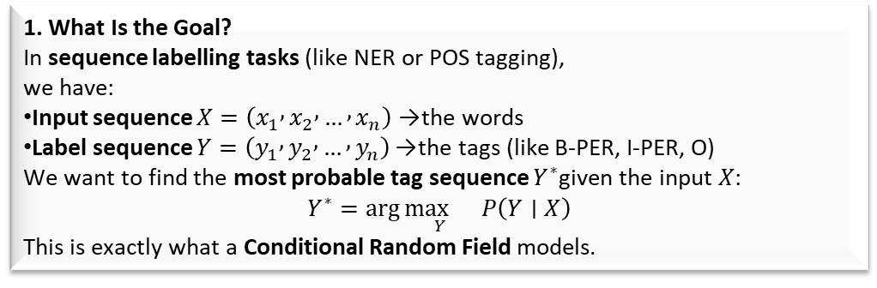
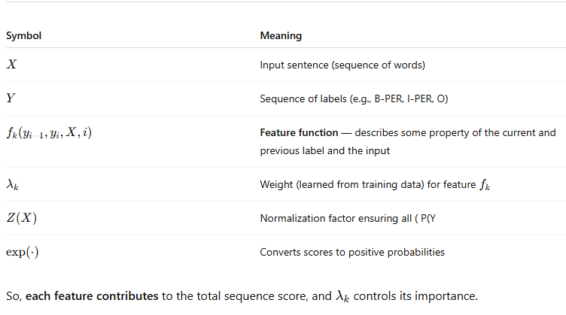
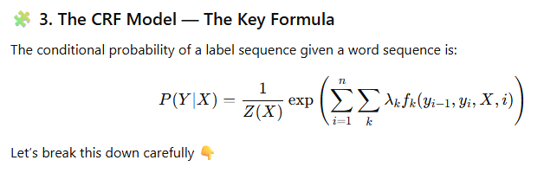
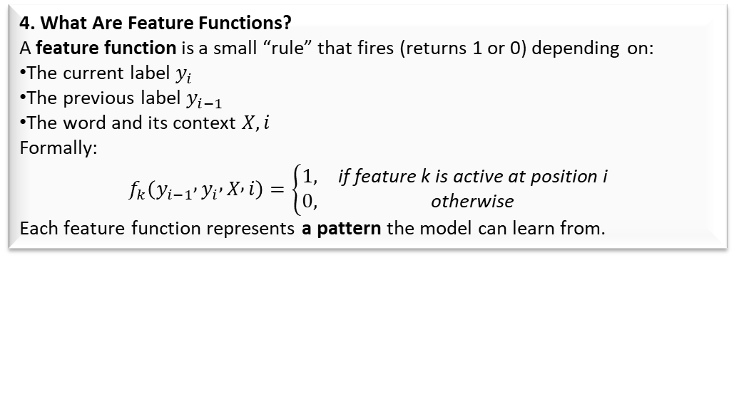
How CRF works
⚙️ 2. What Is a CRF Doing Conceptually?
A CRF looks at all possible label sequences for a sentence.
It assigns each possible sequence a score (based on features).
Then it normalizes those scores into probabilities.
Finally, it picks the highest-probability label sequence.

Slide 19
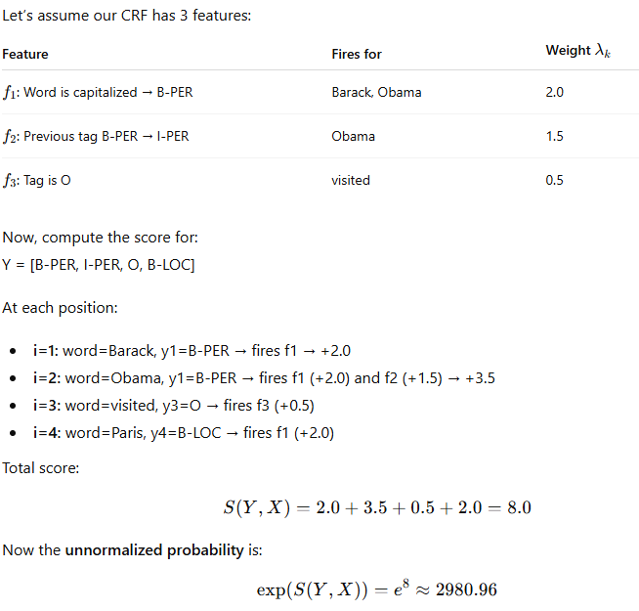
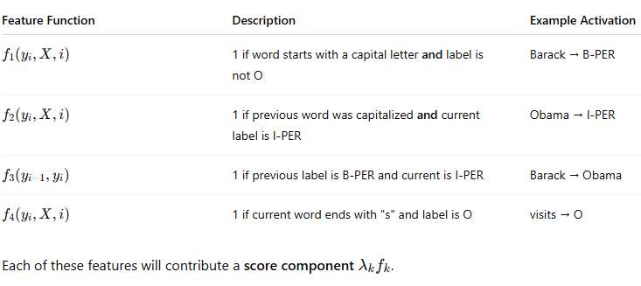
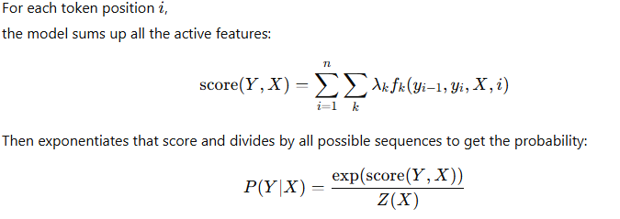
How CRF works
Sentence:
“Barack Obama visited Paris”
Input tokens:
X = [Barack, Obama, visited, Paris]
Labels (Y):
Y = [B-PER, I-PER, O, B-LOC]

Slide 20
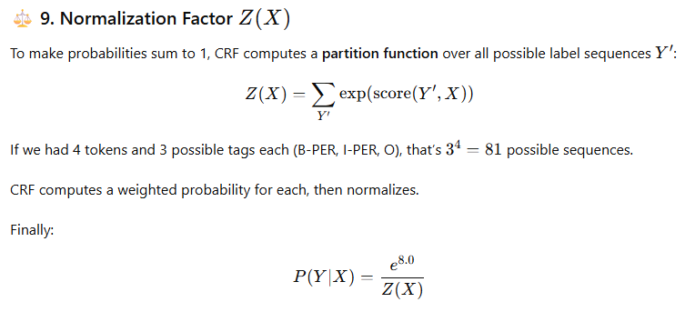
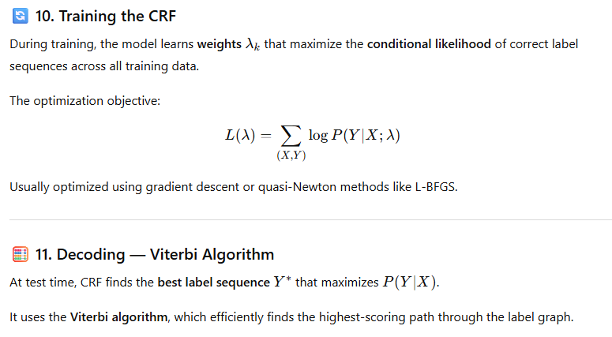
How CRF works

Slide 21
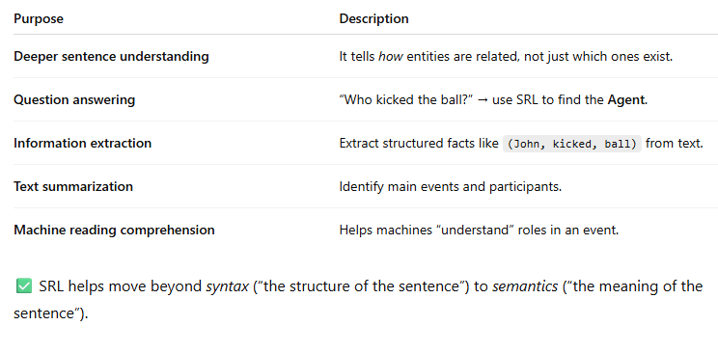
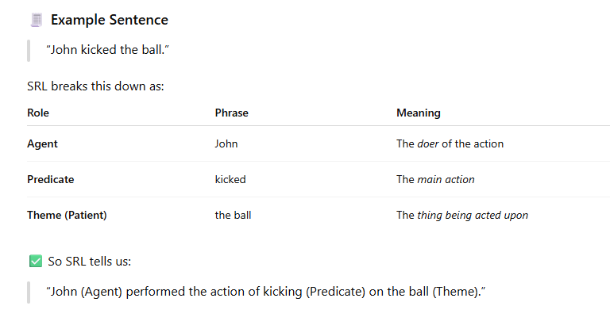
Semantic Role Labelling
💡 2. Why SRL Is Required
🧠 1. What Is Semantic Role Labelling?
Semantic Role Labeling (SRL) is the process of analyzing the meaning structure of a sentence —
it identifies who did what to whom, when, where, and how.
In short, it assigns roles to words or phrases that describe how they participate in an event.
⚙️ 3. How SRL Works (Conceptually)
Predicate Detection → Find the main verb(s) or event word(s).
Example: “kicked”
Argument Identification → Find related noun phrases or clauses.
Example: “John”, “the ball”
Role Classification → Assign semantic roles to each argument:
  ARG0 → Agent (doer)
  ARG1 → Theme / Patient (thing acted upon)
  ARGM-LOC → Location
  ARGM-TMP → Time
  etc.
These labels come from PropBank — a linguistic resource defining typical roles for each verb.

Slide 22
Coreference Resolution
🧠 What is Coreference Resolution?
Coreference Resolution is the task of finding all expressions (mentions) in a text that refer to the same real-world entity.
In short:
It finds “who” or “what” a pronoun or noun phrase refers to.
💡 Why is Coreference Resolution Needed?
It’s essential for real understanding in NLP tasks.
Area | Why it matters
Question Answering | “Who won the match? He was very happy.” → “He” must be linked to the person who won.
Information Extraction | Combine facts about the same entity: “Riya joined Google. She works in AI.”
Text Summarization | Prevents repetition and improves coherence.
Dialogue Systems | Understanding references like “Yes, I liked it too” → what does “it” mean?
🗣 Example 1
“Riya went to the park. She played football.”
Here:
“Riya” → antecedent (the original mention)
“She” → pronoun referring to the same entity
So both belong to the same coreference cluster.
🟢 Cluster: {Riya, She}
🗣 Example 2
“John told Peter that he would win.”
Ambiguous!
Who is “he”? → John or Peter?
Coreference resolution models must decide, based on context, which entity “he” refers to.
🧩 How It Works (Conceptually)
Detect mentions — identify all noun phrases, names, and pronouns.
“Riya”, “She”, “The girl”, “Her friend”
Extract features for each pair:
  Gender / Number (singular/plural)
  Grammatical role (subject, object)
  Semantic similarity (name vs pronoun)
  Distance (how far apart)
  Contextual embedding similarity (if deep model)
Predict whether they refer to the same entity.
  If yes → link them into one cluster.

Slide 23
Coreference Resolution
⚙️ Approaches
Type | Description
Rule-based | Uses syntactic + gender/number agreement rules (e.g., Hobbs algorithm).
Statistical (ML) | Train a model using pairwise features.
Neural (Deep Learning) | Modern approach — uses embeddings from BERT, SpanBERT, etc., to understand context.

Slide 24
Thank You!!

